Slide 1








UNDERSTANDING SQL
Hands-on Exercise
Reference
Questions
Points To Ponder
Coding Standards
Lend A Hand
Summary
Test Your Understanding

Slide 2

OVERVIEW
Understanding ANSI SQL session provides knowledge and understanding of Relational Database Management System, Normalization, and ANSI SQL.
3

Slide 3

OBJECTIVES
At the end of this session, you will be able to:
  Define Database Management System (DBMS)
  Recall the concept that a developer needs to have, to work with it
  Define Database (DB)
  Describe Data Model
  Define Relational Database Management System (RDBMS)
  Describe Database Normalization
  Define Structured Query Language (SQL)
4

Slide 4
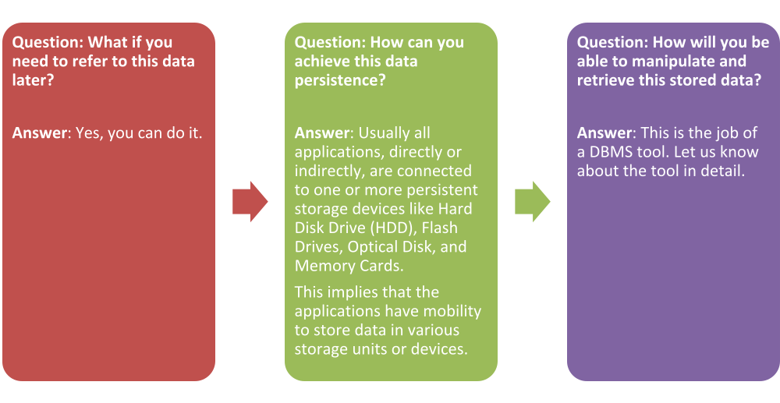
INTRODUCTION
After learning Programming Fundamentals, you might have encountered a need to retain the data which is input, manipulated, and displayed by your code.
Program manipulates data in RAM which is volatile storage.
5

Slide 5
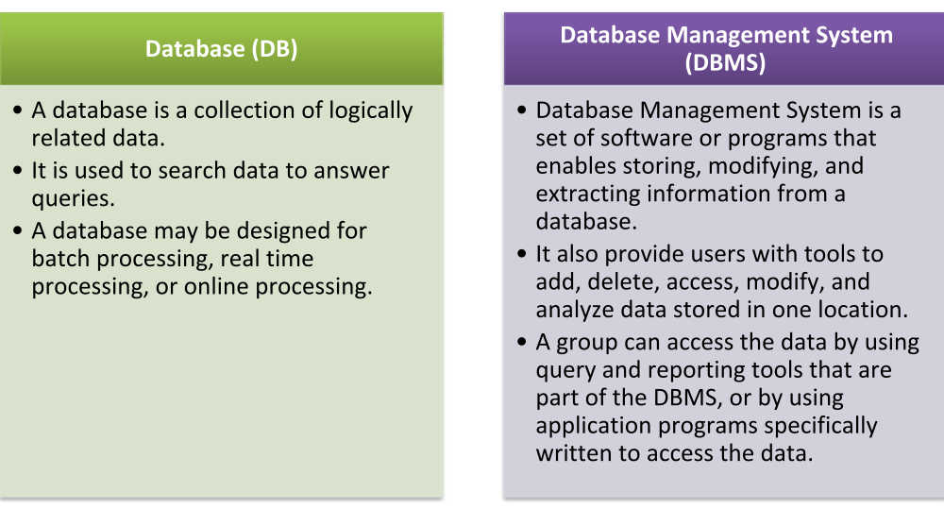
WHAT IS DBMS?
6

Slide 6

DATA MODELS
How are the data modeled or structured in DBMS?
  To answer this, let us understand the concept of Data Models.
A Data Model is a representation of a real world situation about which data is to be collected and stored in a database. A data model depicts the dataflow and logical interrelationship among different data elements.
7

Slide 7
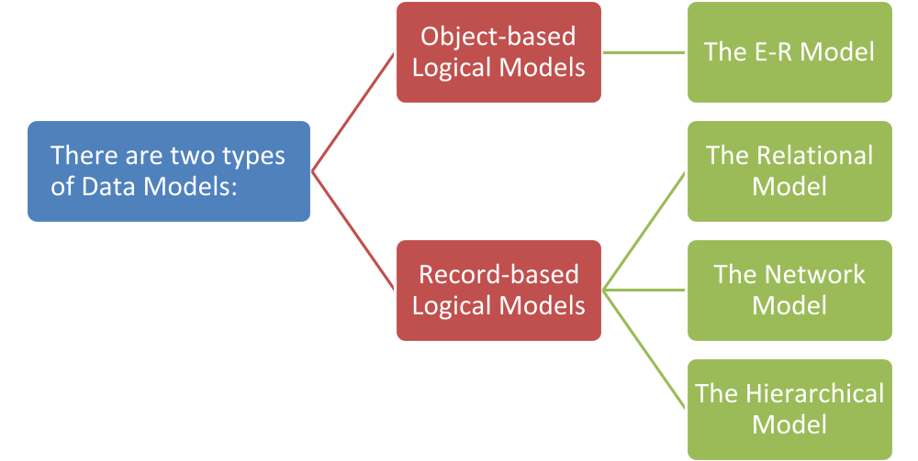
TYPES OF DATA MODELS
8

Slide 8
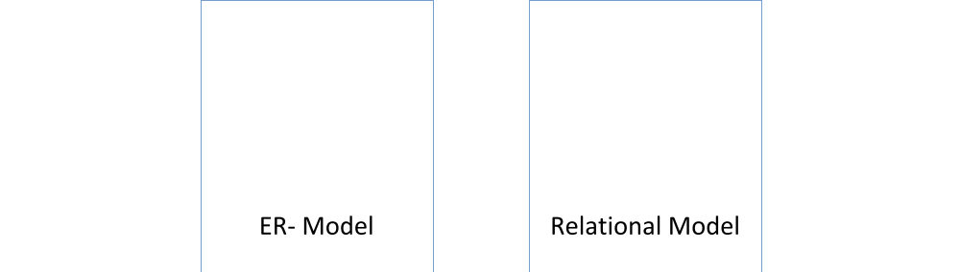
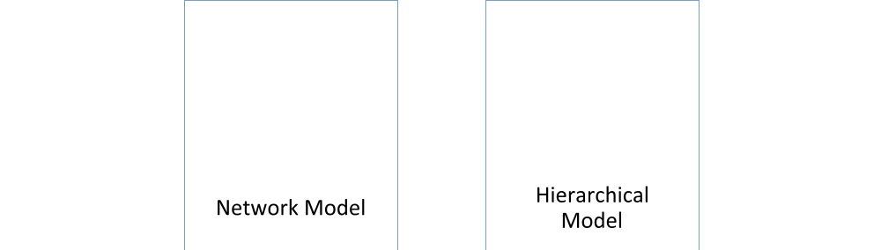
TYPES OF DATA MODELS (CONTD.)
9

Slide 9
OBJECT-BASED LOGICAL MODELS
Object-based Logical Models:
They describe data at conceptual and view levels.
The E-R Model:
  The Entity-Relationship model is based on a perception of the world as a collection of basic objects (entities) and relationships among these objects.
10

Slide 10
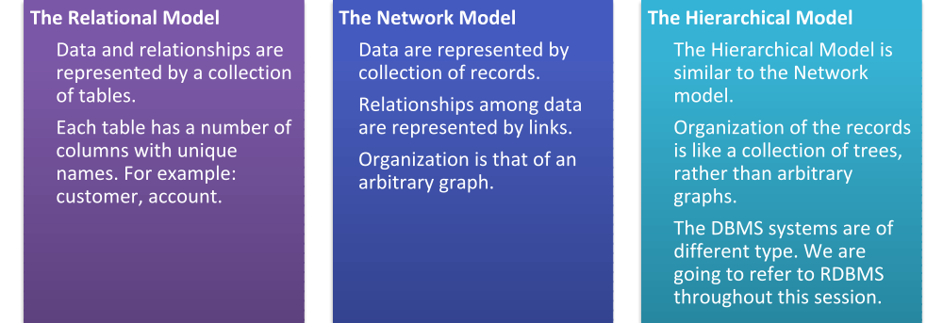
RECORD-BASED LOGICAL MODELS
Record-based Logical Models:
Unlike object-oriented models, this is used to:
  Specify overall logical structure of the database, and
  Provide a high-level description of the implementation
As the name implies, in this model the database is structured in fixed-format records of several types.
Each record type defines a fixed number of fields or attributes.
11

Slide 11
DEFINITION OF RDMS
Relational Database Management System (RDBMS) is a Database Management System (DBMS) that is based on the Relational model.
12

Slide 12
DATABASE NORMALIZATION
How to reduce data redundancy and inconsistency in database tables?
  Data redundancy and inconsistency in database tables can be reduced by following a process called Normalization.
Database Normalization:
  Database Normalization is the process of organizing the fields and tables of a relational database to minimize redundancy and dependency.
  Normalization usually involves dividing large tables into smaller (and less redundant) tables and defining relationships between them.
  The objective is to isolate data so that additions, deletions, and modifications of a field can be made in just one table and propagated through the rest of the database via defined relationships.
13

Slide 13
NORMAL FORMS
Normal Forms:
  Edgar F. Codd, the inventor of the Relational Model, introduced the concept of Normalization in 1970. We now know this concept as the First Normal Form (1NF).
  Codd went on to define the Second Normal Form (2NF) and Third Normal Form (3NF) in 1971, and Codd and Raymond F. Boyce defined the Boyce-Codd Normal Form (BCNF) in 1974.
  Informally, a relational database table is often described as "normalized" if it is in the Third Normal Form. Most 3NF tables are free of insertion, update, and deletion anomalies.
14

Slide 14
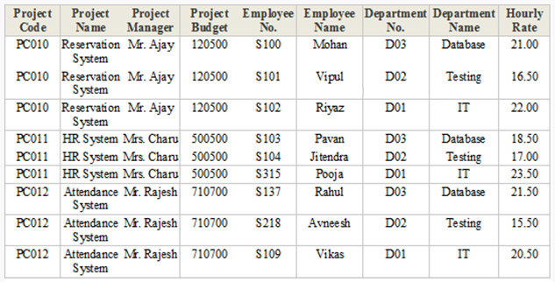
NORMAL FORMS (CONTD.)
To understand normal forms, consider the following denormalized database table. Now we will normalize the data of the following table using normal forms.
15

Slide 15
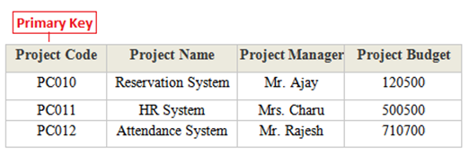
FIRST NORMAL FORM
First Normal Form (1NF):
  A database table is said to be in 1NF if it contains no repeated fields or columns.
  The process of converting the UNF table into 1NF is as follows:
    Separate the repeated fields into new database tables along with the key from de-normalized database table.
    The primary key of new database tables might be a composite key.
16

Slide 16
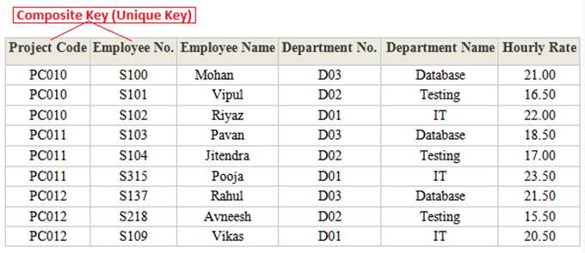
FIRST NORMAL FORM (CONTD.)
First Normal Form (1NF)
17

Slide 17
SECOND NORMAL FORM
Second Normal Form (2NF):
  A database table is said to be in 2NF if it is in 1NF and contains only those fields or columns that are functionally dependent (the value of the field is determined by the value of another field(s)) on the primary key.
  In 2NF, we remove the partial dependencies of any non-key field.
  The process of converting the database table into 2NF is as follows:
    Remove the partial dependencies (a type of functional dependency where a field is only functionally dependent on the part of primary key) of any non-key field.
    If field B depends on field A and vice versa, for a given value of B, we have only one possible value of A and vice versa, then we put the field B into new database table. In the new table, B will be primary key and also marked as foreign key in parent table.
18

Slide 18
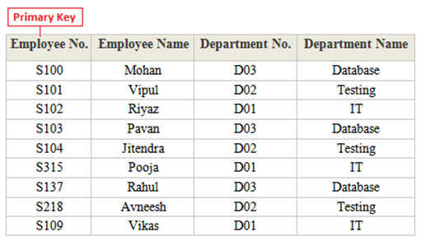
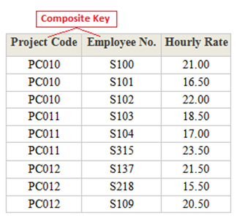
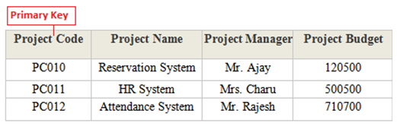
SECOND NORMAL FORM (CONTD.)
Second Normal Form (2NF):
  2NF of the 1NF tables shown above are as follows:
19

Slide 19
THIRD NORMAL FORM
Third Normal Form (3NF):
  A database table is said to be in 3NF if it is in 2NF and all non key fields are dependent on a primary key. We can also consider a table to be in 3NF if it is in 2NF and none of the fields of the table are transitively functionally dependent on the primary key.
  The process of converting a table into 3NF is as follows:
    Remove the transitive dependencies (a type of functional dependency where a field is functionally dependent on the field that is not the primary key. Hence its value is determined, indirectly by the primary key).
    Make separate table for transitive dependent field.
20

Slide 20
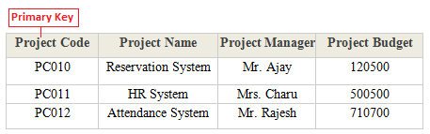
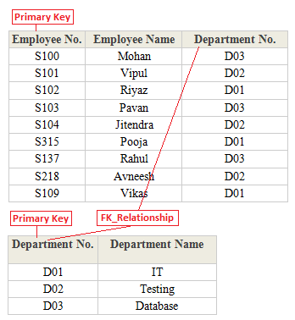
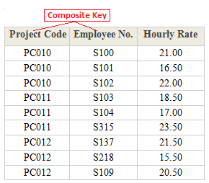
THIRD NORMAL FORM (CONTD.)
Third Normal Form (3NF):
21

Slide 21


SQL

Slide 22
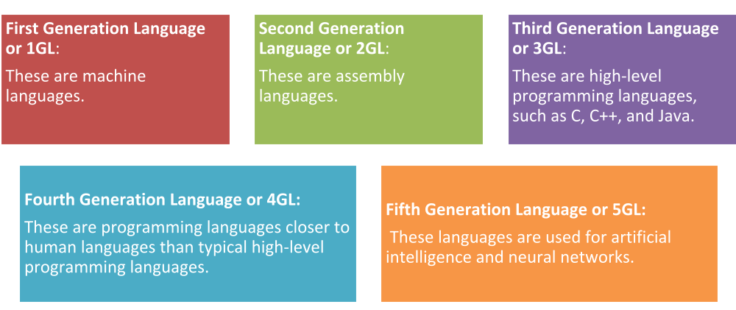
SQL
Structured Query Language (SQL):
  It is a special-purpose programming language designed for managing data in RDBMS.
  It is a 4th Generation Language or 4GL.
What is 1GL, 2GL, 3GL, 4GL, 5GL?
25

Slide 23


ANSI SQL
Question: Does projects recommend knowledge of ANSI SQL?
Answer: Yes
American National Standards Institute (ANSI):
  It is a private non-profit organization that is responsible for development of voluntary standards for products, services, processes, systems, and personnel in the United States.
  SQL was adopted as a standard by the American National Standards Institute (ANSI) in 1986 as SQL-86 and the International Organization for Standardization (ISO) in 1987.
Question : Do you want more clarification on why one should follow ANSI?
Answer: Let us understand why one should adhere to ANSI.
In this course, we will adhere to ANSI SQL syntax.
24

Slide 24
WHY ANSI SQL?
Why do we need ANSI SQL standard?
  Without a central standard entity, every database manufacturer would be free to use whatever syntax they find appropriate.
  Even though there are some variations from one to the next regarding various extensions, the main code is going to be the same from one to another.
  A SELECT will always be a SELECT instead of a SELECT on one, GET on another, READ on a third, etc.
  This will not allow vendor based monopoly.
Note: Every vendor available in market has their own DIALECTS (something additional apart from ANSI recommendation).
“The dialect of the database is simply a term that define the specific features of the SQL language that are available when accessing that database.”
26

Slide 25
QUESTIONS
27

Slide 26
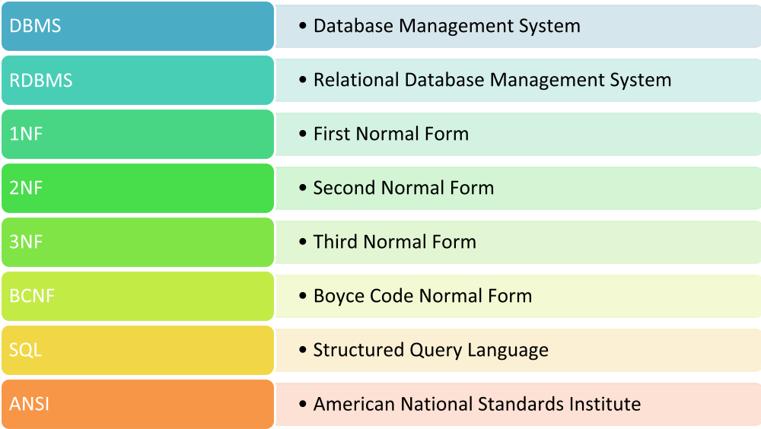
KEYWORDS
28
Notes:
C3 : Protected

Slide 27

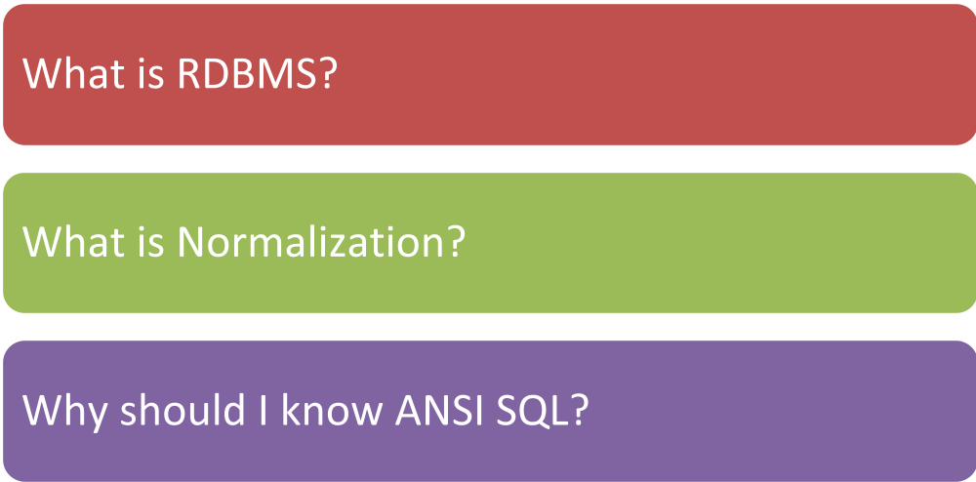
CHECK YOUR UNDERSTANDING
29

Slide 28

SUMMARY
In this session you have learned the following:
  Database (DB) is a collection of logically related data.
  Database Management System (DBMS) is a set of software or programs that enables storing, modifying, and extracting information from a database.
  Data Model is a representation of a real world situation about which data is to be collected and stored in a database.
  Relational Database Management System (RDBMS) is a Database Management System (DBMS) that is based on the Relational model.
31

Slide 29
SUMMARY (CONTD.)
Database Normalization is the process of organizing the fields and tables of a relational database to minimize redundancy and dependency.
Structured Query Language (SQL) is a special-purpose programming language designed for managing data in Relational Database Management Systems (RDBMS).
SQL was adopted as a standard by the American National Standards Institute (ANSI) in 1986 as SQL-86 and the International Organization for Standardization (ISO) in 1987.
30

